Slide 1
Presenting TSTL
(and the Quest for One Test to Rule Them All)
Alex Groce
Oregon State University

Slide 2
Presenting TSTL
(and the Quest for One Test to Rule Them All)
Alex Groce
Oregon State University
Contributions from:
Josie Holmes, Jervis Pinto, Pranjal Mittal,
Pooria Azimi, Francis Vo, and CS362 and 562 students

Slide 3
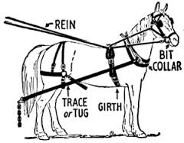
Test Harness
Defines (and usually tells how to generate) the set of valid tests for a program (the System Under Test – SUT)
Before testing, have to know what to test
Common task in software model checking and automated testing
SPIN, JPF, CBMC, KLEE, random testing, bounded exhaustive testing, etc.
I’ve spent a good part of my working life as a researcher writing test harnesses of some kind or other

Slide 4



The Problem
Harness writing
is time-consuming
is error-prone
involves lots of repetitive, semi-redundant code that is hard to refactor
tends to lock you in to a particular method for testing/verification

Slide 5
Proposal: A Little Language
Need a language for defining valid tests
Lightweight Domain-Specific Language (DSL) targeting the things we do in test harnesses – making choices, calling functions, building up input values, checking properties
Separate test generation from test definition
Use different testing / model checking algorithms without redefining “valid tests”
Platform for experimenting with new test generation algorithms and debugging methods

Slide 6
Four Parts of the Talk
An overview of the idea of TSTL
Demonstration of TSTL
Normalizing and generalizing tests
Future work / other projects
Please ask questions as we go!

Slide 7
Part I: The Template Scripting Testing Language

Slide 8
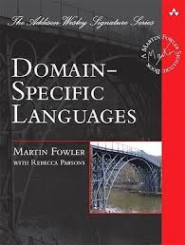
Domain-Specific Languages
Used for specialized tasks that involve certain common idioms
Make specialized kinds of programming easier – code is more concise, more reliable
Often declarative vs. imperative
Big productivity gains for non-traditional programmers are possible (e.g. scientists, data analysts)
Sounds like a good fit for test harness coding

Slide 9

Domain-Specific Languages
On the other hand:
Test harnesses usually need to compute a variety of things, sometimes complex
Who wants to learn a new language that’s only good for one thing?
Much of the harness is in the language of the SUT, in a typical case
Solution: embed existing language in the DSL
Inspired by SPIN model checker’s use of C code

Slide 10
Template Scripting Testing Language
Template
TSTL compiles to code in the language of the SUT
So you can freely mix in “raw code”
Scripting
Expect the “host” language often will be a scripting language for concise, easy-to-read code
Testing Language
TSTL is only for defining valid test + properties

Slide 11
Basic Idea
TSTL harness describes structure of a test + properties (and perhaps logging)
TSTL compiles this into a class that satisfies an abstract interface that allows a test generator to interact with the SUT as a (possibly infinite) graph
Class allows reset, query of enabled transitions, performing actions, checking properties, setting logging levels, backtrack & replay, delta-debugging, sandboxing, annotation of tests…

Slide 12
Trivial Example
TSTL harness definition:
pool: <int> 1
pool: <list> 1
<int> := <[1..2]>
<list> := []
<list>.append(<int>)
property: len(<list>) <= 20
(,)
int0 = 1
int0 = 2
list0= []
(1,)
(2,)
(,[])
(,[])
int0 = 1
int0 = 2
(1,[])
(1,[])
(2,[])
list0.append(int0)
Access via API:
sut.restart(), sut.actions(), sut.check()…
action =
<ID: str × guard: ()->bool × act: ()->()>
(1,[1])

Slide 13
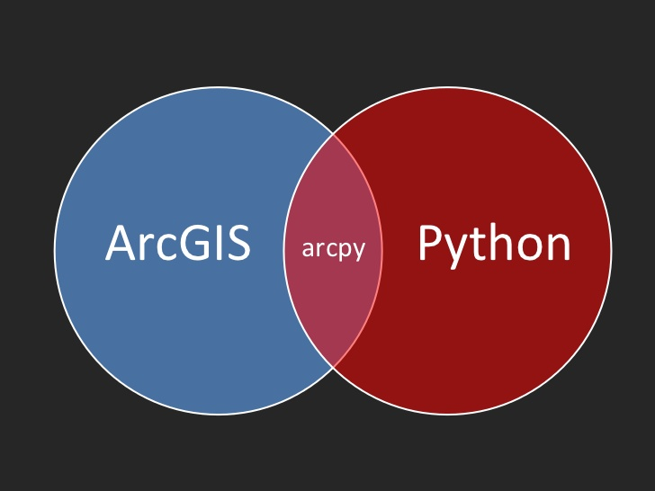
Very Non-Trivial Example: Esri ArcPy
ArcGIS is most widely used Geographic Information System software platform
ArcPy released with ArcGIS 10
Allows scripting of ArcGIS functions in Python
Large, complex Python library
Over 50,000 lines of code in Python + unknown but very large C++ code underlying
Calls to the ArcGIS engine to perform tasks
Dozens of classes, hundreds of functions
ArcPy is latest in a long line of ways to script/automate ArcGIS

Slide 14


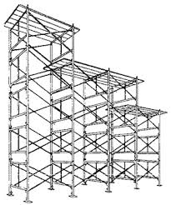
Automated Test Generation for ArcPy
Build a system to find faults in ArcPy
There are faults – every user has seen ArcGIS crash
Usable testing: find ArcPy faults (and ArcGIS faults) without too much human effort or testing expertise
Extensible testing: build a system that is a starting framework for future efforts to better test ArcPy / ArcGIS
Notes:
Hard to debug ArcPy code when it just causes a crash
Want to make a system that is a starting place for making ArcPy, or libraries built on top of ArcPy, more reliable
Needs to be useable by GIS experts, not just experts in testing

Slide 15
Automated Test Generation for ArcPy
TSTL implementation by a Penn State GIS MS student, with some advice/help
Already discovered 5-6 crashing faults, undocumented restrictions on API usage, and so forth
Some nice improvements to TSTL language and tools on the way
Notes:
Hard to debug ArcPy code when it just causes a crash
Want to make a system that is a starting place for making ArcPy, or libraries built on top of ArcPy, more reliable
Needs to be useable by GIS experts, not just experts in testing

Slide 16
Very Simple TSTL for ArcPy
﻿@import arcpy
@from arcpy import ExecuteError
pools:
<shapefile> 2
<out> 2
<amt> 2
<dist> 2
actions:
<shapefile> := arcpy.env.workspace + “\\file1.shp”
<shapefile> := arcpy.env.workspace + “\\file2.shp”
<out> := arcpy.env.workspace + “\\new1.shp”
<out> := arcpy.env.workspace + “\\new2.shp”
<amt> := <[1..50]>
<dist> := str(<amt>) + “ Feet”
<dist> := str(<amt>) + “ Meters”
{ExecuteError} arcpy.Buffer_analysis(<shapefile>,
<out>, <dist>)
Notes:
This is a very simple TSTL “harness” (what they call a definition of tests) for ArcPy
Only calls one function, producing a Buffer, and it is the simplest way to call Buffer, with no optional arguments
Pools are the values used in parameters. They can be re-used, to make tests easier to read and more likely to find problems
Buffer needs a feature class (here just a shapefile), a feature class to output to (here a shapefile again), and a distance for the buffer.
This lets the shapefiles be just fixed values, but allows the distance to be either in feet or meters, and between 1 and 50 in quantity
The curly braces on ExecuteError mean that if the buffer causes an error, that is allowed (for instance, if the file does not exist, or something)

Slide 17
Building arcpy.tstl
First choose an ArcPy function to call, and determine parameters it needs:
For this example, will need pools for classorlayerlist, featureclass, joinattributes, and dist, which may also need other pools
For example:
{ExecuteError} arcpy.Intersect_analysis(<classorlayerlist>,
<featureclass>, join_attributes=<joinattributes>,
cluster_tolerance=<dist>);
<classorlayerlist> := []
<classorlayerlist>.append(<classorlayer>)
<classorlayer> := <featureclass>
<classorlayer> := <newlayer>
Notes:
If we pick intersect, we need several parameters to call it
Some of these are quite complex to make available!

Slide 18
Building arcpy.tstl
To choose a feature class, needs more work, just for shapefiles:
<featureclass> := <shapefile>
len(<gdbfeatureclasslist,1>) >= 1 -> <featureclass> :=
<gdbfeatureclasslist>[0]
<shapefilelist> := sorted(glob.glob(arcpy.env.workspace +
"\\*.shp"))
len(<shapefilelist,1>) >= 1 -> <shapefile> :=
<shapefilelist> [0]
<shapefilelist> = <shapefilelist> [1:]
<shapefile> := arcpy.env.workspace + "\\new1.shp"
<shapefile> := arcpy.env.workspace + "\\new2.shp"
<shapefile> := arcpy.env.workspace + "\\new3.shp"
Notes:
Let the system pick a shapefile from ones that are in a special working temporary directory for each test

Slide 19
A Failing Test Case
shapefilelist0 = sorted(glob.glob(arcpy.env.workspace + "\*.shp")) # step 0
shapefile0 = shapefilelist0 [0] # step 1
featureclass0 = shapefile0 # step 2
#[
classorlayer0 = featureclass0 # step 3
fieldtype0 = "DOUBLE” # step 4
# or fieldtype0 = "TEXT” or “FLOAT” or “SHORT” or “LONG” or “DATE”
^{# swaps with step 6}
fieldname0 = "newf1” # step 5
^{# or fieldname0 = "newf3"}
^{# swaps with steps 6 and 8}
#] (steps in [] can be in any order)
#[
insertcursor0 = arcpy.InsertCursor(classorlayer0) #step 6
^{# swaps with steps 4 and 5}
arcpy.AddField_management(featureclass0,fieldname0,fieldtype0); report() #step 7
#] (steps in [] can be in any order)
fieldname0 = "newf2” # step 8
^{# or fieldname0 = "newf3"}
^{# swaps with step 5}
arcpy.AddField_management(featureclass0,fieldname0,fieldtype0); report() # step 9
insertcursor0 = arcpy.InsertCursor(classorlayer0) # step 10
Before reduction and normalization, test had hundreds of steps

Slide 20

Status of TSTL
TSTL language is heavily developed
Papers at NASA Formal Methods 2015, ISSTA 2015
Released as a Python package, with example code and documentation, integrated with Python code coverage tools (and found some bugs in those tools)
Includes a few testing tools: a sophisticated random test generator, some simple model checkers, some experimental algorithms
TSTL used to test TSTL
Beta version for Java

Slide 21

Why Python?
Python is very popular
Widely used in both practice and education (many top CS schools use it as their intro language)
Particularly adopted in scientific computing, etc.; used to analyze/modify complex data
NumPy, SciPy, biopython, ArcPy (end users), QIIME
Python needs good testing solutions!
Lack of a static type system means libraries can hide some very troublesome bugs

Slide 22
Part II: TSTL in Action

Slide 23
Part III: The Quest for
One Test to Rule Them All

Slide 24

The Sorcerer's Apprentice
Consider using TSTL to test a container class library – e.g. simple AVL tree
Suppose there are two distinct faults in the class
Run random testing for half an hour, storing all failing tests as files

Slide 25

The State of the Art: Buried in Redundancy
Likely to find a directory containing hundreds of failing tests
Only two faults – why so many failures?

Slide 26
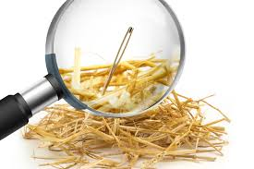
It Gets Worse
Highly possible one of these faults will appear hundreds of times, the other only a few times
What if the more common fault is hard to understand, or hard or impossible to fix?

Slide 27

A Not-So Modest Goal: One Test to Rule them All
For every fault in the SUT
Generate only one failing test case
Annotated with information about other variants that expose the same fault in the SUT
Eliminate the haystack, and ease debugging the needles

Slide 28
Normalization and Generalization
Total success is probably impossible due to fundamental constraints (halting problem equivalence)
Two partial solutions:
Normalize tests by using term rewriting to modify superficially different tests into the same test
Generalize tests by performing experiments and giving user information on nearby variations of the test that also cause failure

Slide 29
Normalization and Generalization
TSTL makes normalization and generalization easy to implement
Defines a total order on all possible actions in a test, provides test case reduction algorithms
Notion of “simpler test” makes sense in a new way
Define a set of rewriting rules that are strongly normalizing, and an application strategy to optimize performance

Slide 30
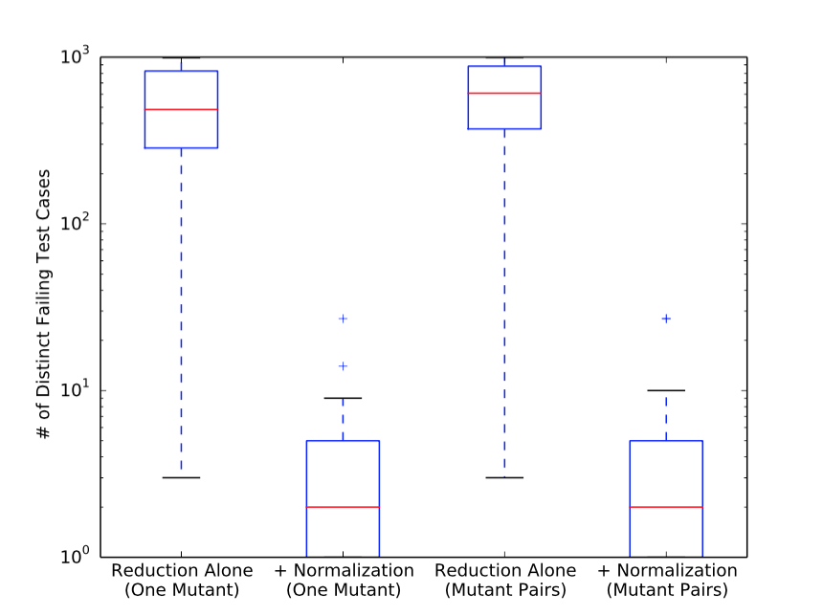
Results for AVLTree Faults

Slide 31
Normalization and Generalization
In addition to reducing the number of redundant test cases, normalization and generalization makes it easier to understand failing tests and debug
For the ArcPy example earlier, normalization reduced the length of the test by 6 steps (from 17 to 11)
No more problem of trying to figure out if the “14” appearing in a random test is important, or if any number will do

Slide 32
A Failing Test Case
shapefilelist0 = sorted(glob.glob(arcpy.env.workspace + "\*.shp")) # step 0
shapefile0 = shapefilelist0 [0] # step 1
featureclass0 = shapefile0 # step 2
#[
classorlayer0 = featureclass0 # step 3
fieldtype0 = "DOUBLE” # step 4
# or fieldtype0 = "TEXT” or “FLOAT” or “SHORT” or “LONG” or “DATE”
^{# swaps with step 6}
fieldname0 = "newf1” # step 5
^{# or fieldname0 = "newf3"}
^{# swaps with steps 6 and 8}
#] (steps in [] can be in any order)
#[
insertcursor0 = arcpy.InsertCursor(classorlayer0) #step 6
^{# swaps with steps 4 and 5}
arcpy.AddField_management(featureclass0,fieldname0,fieldtype0); report() #step 7
#] (steps in [] can be in any order)
fieldname0 = "newf2” # step 8
^{# or fieldname0 = "newf3"}
^{# swaps with step 5}
arcpy.AddField_management(featureclass0,fieldname0,fieldtype0); report() # step 9
insertcursor0 = arcpy.InsertCursor(classorlayer0) # step 10
Comments (gray text) are the generalization information

Slide 33
Part IV: Future Work/Other Projects

Slide 34
Future Work on TSTL
More powerful normalization / methods for deciding “this test is just like that test”
More powerful generalization
Implement in other languages
Scala, C, C++, insert your favorite language here
For C/C++ NASA funded grant for exploring commercialization potential
Integrate with new novel test generators
Implement automatic, easy to use, security property checks
Improve usability, user interface, speed

Slide 35



Other Projects
DARPA BRASS program funded research on survivable/adaptable systems
Software that can “live 100 years”
My part: discovering resource dependencies (and how to handle changes to environment) via mutation analysis
Understanding opaque systems
With US Forest Service researchers
Input: large, complex, many components
Output: contains few clues about the computation that took place, may have sub-components
Idea: dynamic version of quantitative information flow – per component “input X 20% responsible”
Previous work – testing machine learning systems
Collaboration with security research company Trail of Bits

Slide 36


Other Projects
Better metrics for comparing program executions (NSF proposal in submission)
Use program mutants, and measure mutant response (how does program change alter execution correctness?)
Apply advanced machine learning (Bayesian optimization, deep learning)
Improved previous results on identifying compiler faults
Improvement on state-of-the-art automatic fault localization techniques
Next steps: help JPL operators handle Curiosity rover telemetry, identify anomalies

Slide 37

Other Projects
Using mutants to ensure software verification actually verifies the right thing
Presented at ASE 2015, working with Linux kernel developer at IBM
Related work on using mutants to improve complex test suites for systems software – we have one Linux kernel bug that’s “ours” so far… USENIX paper in preparation
Automatic search for model-checkable code in open source repositories
Use dynamic invariants to avoid false positives
Foundational work on code coverage, suite evaluation methods (ISSTA13,ICSE14/16...)
Novel test generation algorithms

